Slide 1
Project Presentation
Problem Statement
Houses are one of the necessary need of each and every person around the globe and therefore housing and real estate market is one of the markets which is one of the major contributors in the world’s economy. It is a very large market and there are various companies working in the domain. Data science comes as a very important tool to solve problems in the domain to help the companies increase their overall revenue, profits, improving their marketing strategies and focusing on changing trends in house sales and purchases. Predictive modelling, Market mix modelling, recommendation systems are some of the machine learning techniques used for achieving the business goals for housing companies. Our problem is related to one such housing company.
A US-based housing company named Surprise Housing has decided to enter the Australian market. The company uses data analytics to purchase houses at a price below their actual values and flip them at a higher price. For the same purpose, the company has collected a data set from the sale of houses in Australia. The data is provided in the CSV file below.
The company is looking at prospective properties to buy houses to enter the market. You are required to build a model using Machine Learning in order to predict the actual value of the prospective properties and decide whether to invest in them or not. For this company wants to know:
• Which variables are important to predict the price of variable?
• How do these variables describe the price of the house?
Understanding
We are required to model the price of houses with the available independent variables. This model will then be used by the management to understand how exactly the prices vary with the variables. They can accordingly manipulate the strategy of the firm and concentrate on areas that will yield high returns. Further, the model will be a good way for the management to understand the pricing dynamics of a new market.

Slide 2
EDA Steps
Data Cleaning:- The columns Which has more than 70% of data missing are removed from the dataset.
Checking for the Null Values.
Checking the Outliers using boxplot
Checking the correlation within the columns,
Checking the Multicollinearity using Variance Inflation factor.
Checking the Skewness and removed it with power transfor function.

Slide 3
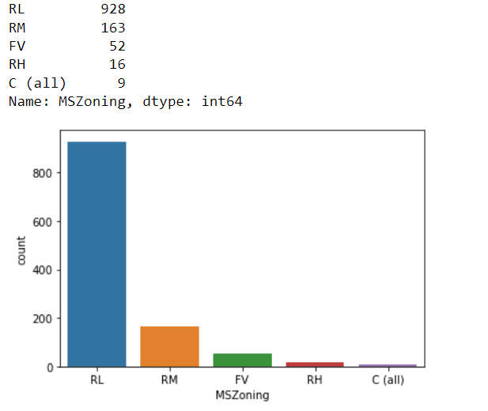
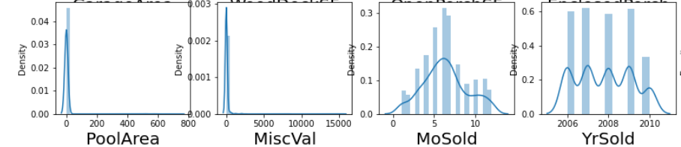
Visualization
Visualization of categorical columns is done with the help of the count plot which count the values of each category and display the graph.
Visualization of the continuous columns is done with the help of dist plot.

Slide 4
Steps and assumptions used to complete the project
First we have read the data.
After that we checked the shape and describe the dataset and analyze some information from that.
After that we have perform the EDA.
Visualization of the dataset.
Checking the outliers and skewness and removal of the skewness.
Checking the multicollinearity.
Training the model with different algorithms and choosing the best model.
Testing the choosed model on the testing file to make predictions.

Slide 5
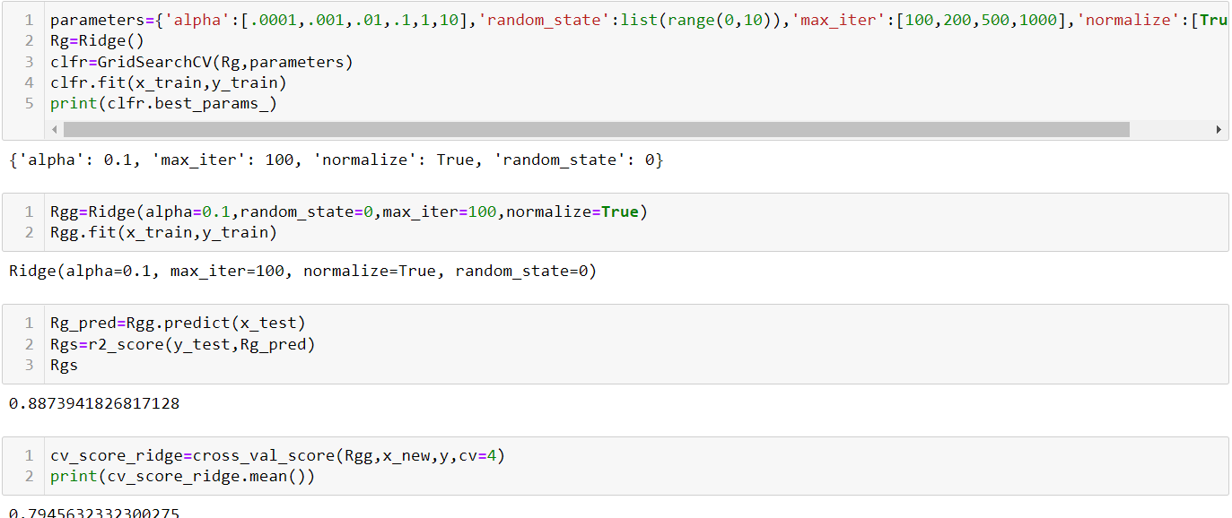
Finalized model
Ridge Regression is or final model for the prediction.

Slide 6
Conclusion
First of all we load the dataset then we see the shape of the dataset i.e 1168 rows and 80 columns and we notice that there are columns which has more than 70% of the empty values that means these columns are not usefull for us ['Alley','MiscFeature','Fence','PoolQC'] so we remove these columns from the dataset. Then we notice that most of the columns have Nan so we dealt those columns by the mean or mode of that column. After that we check for the outliers using the boxplot we found lots of outliers in the columns but those were the categorical columns in which the outliers were present and some outliers are the possible values so we did not remove the outliers from the dataset.
We separately visualize the features and for that we make two different dataframes for the categorical and continuous features . For the categorical we have used the count plot so that we can observe how many unique categories were present in the columns and the number of values lies under those categories.For continuous features we have used the distribution plot and we observe that there is lot of skewness present in the data set which we have dealt with the power transform to remove the skewness.
Since the categorical values were present so we have to encode them to make the prediction for that we have used ordinal encoder.
Thhen we check for the multicollinearity and we found that it exists so we removed some columns to remove mutticollinearity.
Then we trained the model with different algo and we found Ridge regression as the best model for making the predictions.

